Slide 1


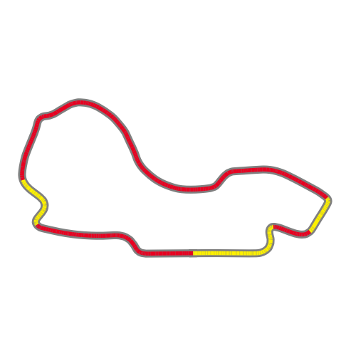


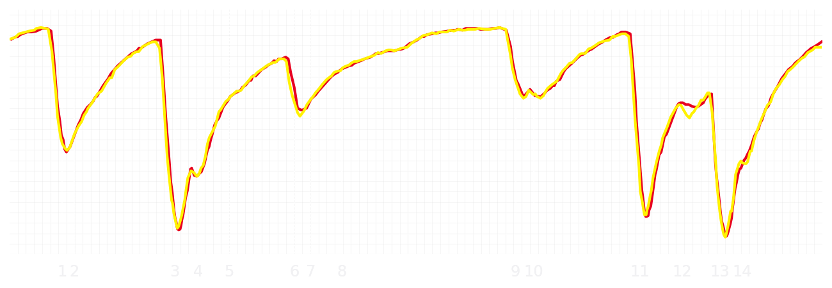
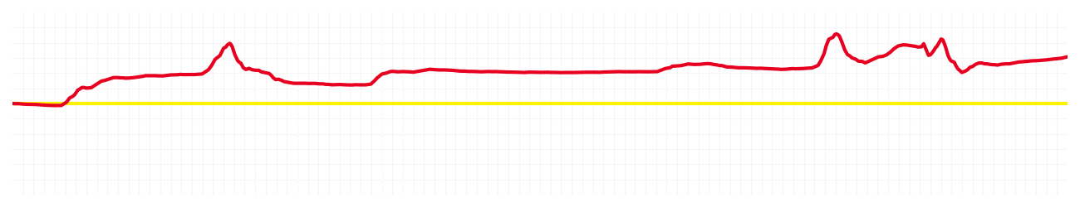
Australian GP Qualifying Q3
Charles Leclerc
Driver
Lewis Hamilton
Driver
Lap Time
01:15.755
01:15.973
Lap Time
Sector 1
26.194
Speed Trap 1
290 kp/h
Speed Trap 1
290 kp/h
Sector 1
26.265
Sector 2
17.025
Speed Trap 2
325 kp/h
Gap
-0.218
Gap
0.218
Speed Trap 2
324 kp/h
Sector 2
17.080
Sector 3
32.536
Speed Final Line
309 kp/h
Corner Advantage
4/15
Corner Advantage
11/15
Speed Final Line
306 kp/h
Sector 3
32.628
FULL THROTTLE
69%
72%
FULL THROTTLE
HEAVY BREAKING
14%
14%
HEAVY BREAKING
%LAP TIME
CORNERING
17%
14%
CORNERING
%LAP TIME
SPEED
SPEED
DELTA TIME
DELTA TIME

Slide 2


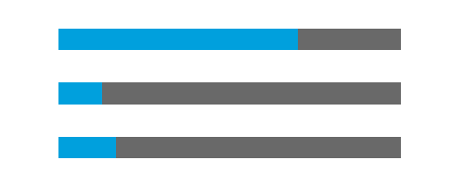

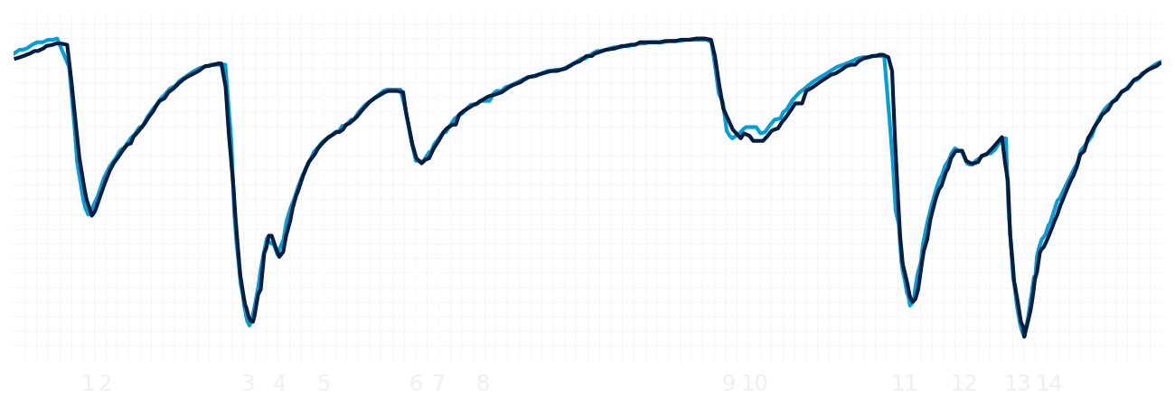
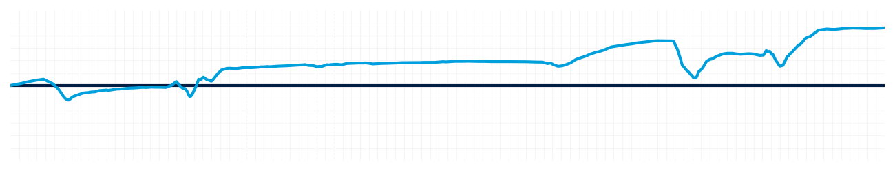
Australian GP Qualifying Q3
Alexander Albon
Driver
Carlos Sainz
Driver
Lap Time
01:15.737
01:16.062
Lap Time
Sector 1
26.215
Speed Trap 1
289 kp/h
Speed Trap 1
289 kp/h
Sector 1
26.355
Sector 2
16.978
Speed Trap 2
329 kp/h
Gap
-0.325
Gap
0.325
Speed Trap 2
329 kp/h
Sector 2
Sector 3
32.544
Speed Final Line
309 kp/h
Corner Advantage
5/15
Corner Advantage
10/15
Speed Final Line
309 kp/h
Sector 3
32.707
FULL THROTTLE
70%
70%
FULL THROTTLE
HEAVY BREAKING
13%
15%
HEAVY BREAKING
%LAP TIME
CORNERING
17%
15%
CORNERING
%LAP TIME
SPEED
SPEED
DELTA TIME
DELTA TIME

Slide 3

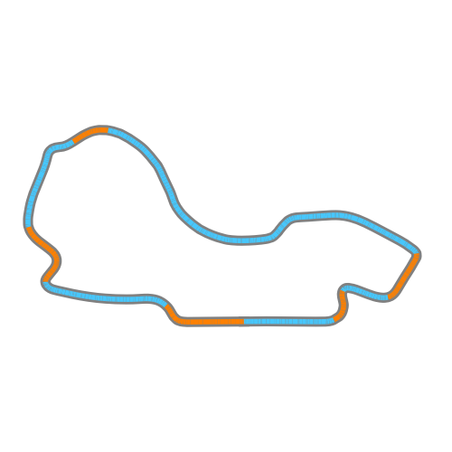

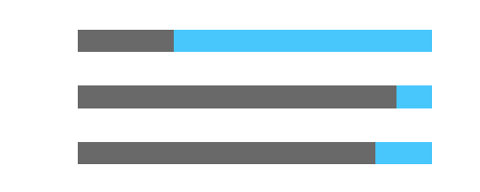
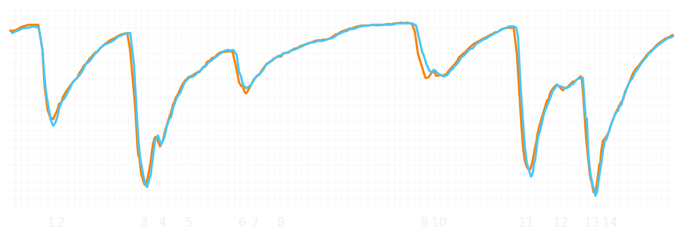
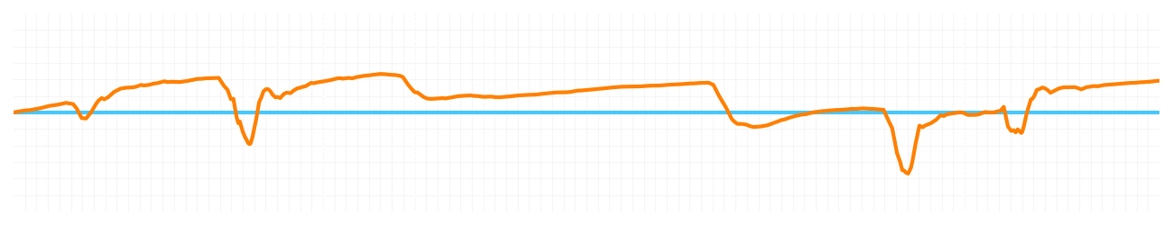
Australian GP Qualifying Q3
Lando Norris
Driver
Oscar Piastri
Driver
Lap Time
01:15.096
01:15.180
Lap Time
Sector 1
25.961
Speed Trap 1
288 kp/h
Speed Trap 1
289 kp/h
Sector 1
26.082
Sector 2
16.997
Speed Trap 2
325 kp/h
Gap
-0.084
Gap
0.084
Speed Trap 2
325 kp/h
Sector 2
16.952
Sector 3
32.138
Speed Final Line
310 kp/h
Corner Advantage
7/15
Corner Advantage
8/15
Speed Final Line
309 kp/h
Sector 3
32.146
FULL THROTTLE
73%
73%
FULL THROTTLE
HEAVY BREAKING
11%
10%
HEAVY BREAKING
%LAP TIME
CORNERING
16%
17%
CORNERING
%LAP TIME
SPEED
SPEED
DELTA TIME
DELTA TIME

